Slide 1

Fauget Skincare
RFM ANALYSIS
By Niloy Saha (Using python)

Slide 2

Fauget Skincare
Introduction
The dataset represents transactional data from a retail/e-commerce business, containing customer purchases, invoice details, and product-level information.
The objective is to analyze customer buying behavior using RFM (Recency, Frequency, Monetary) analysis.
This helps in identifying high-value customers and improving business decision-making

Slide 3
Fauget Skincare
Problem Statement
Businesses often struggle to identify their most valuable customers and understand purchasing patterns.
Without segmentation, marketing efforts become inefficient and less targeted.
The goal is to segment customers based on their purchase behavior and identify key customer groups for strategic decision-making.

Slide 4
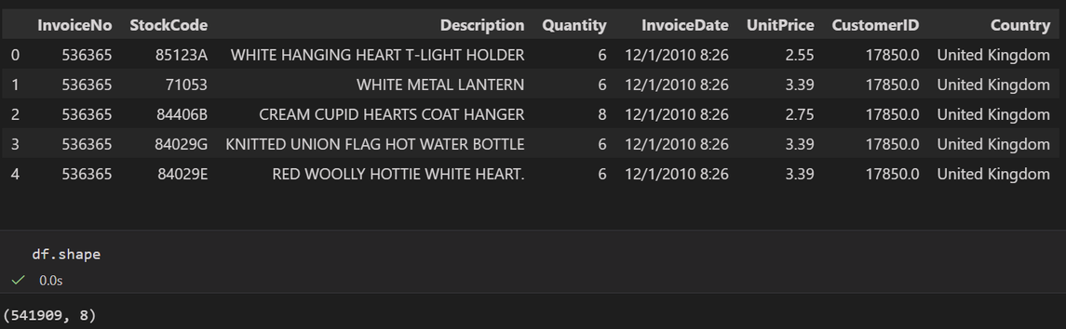
Over view of data set
Fauget Skincare
The dataset contains transactional data of an online retail business.It includes customer purchase records, invoice details, product information, and pricing data.The dataset consists of 5,41,909 rows and 8 columns, representing individual transaction-level records.Each row corresponds to a single product purchased within an invoice.
InvoiceNo → Unique transaction ID
StockCode → Product code
Description → Product name
Quantity → Number of items purchased
InvoiceDate → Date of transaction
UnitPrice → Price per item
CustomerID → Unique customer identifier
Country → Customer location
*Here i delete some unnecessary column for my analysis
and also create some columns for analysis like total_amount

Slide 5
Fauget Skincare
About RFM
What is RFM Analysis?
RFM Analysis is a customer segmentation technique used to evaluate customer behavior based on their purchasing patterns.
It helps businesses identify valuable customers and improve marketing strategies.
R – Recency : How recently a customer made a purchase
F – Frequency : How often a customer makes purchases
M – Monetary : How much money a customer spends
Purpose of RFM
Identify high-value customers
Improve customer retention
Enable targeted marketing strategies
Increase overall revenue

Slide 6
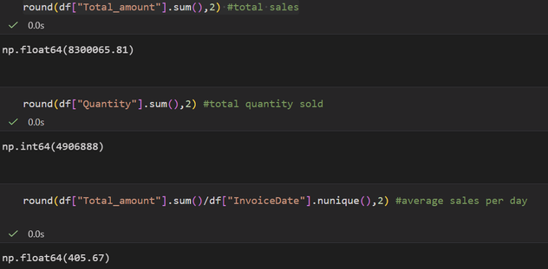
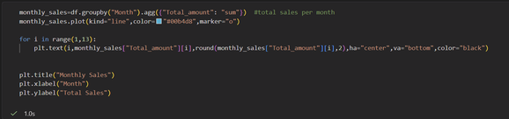
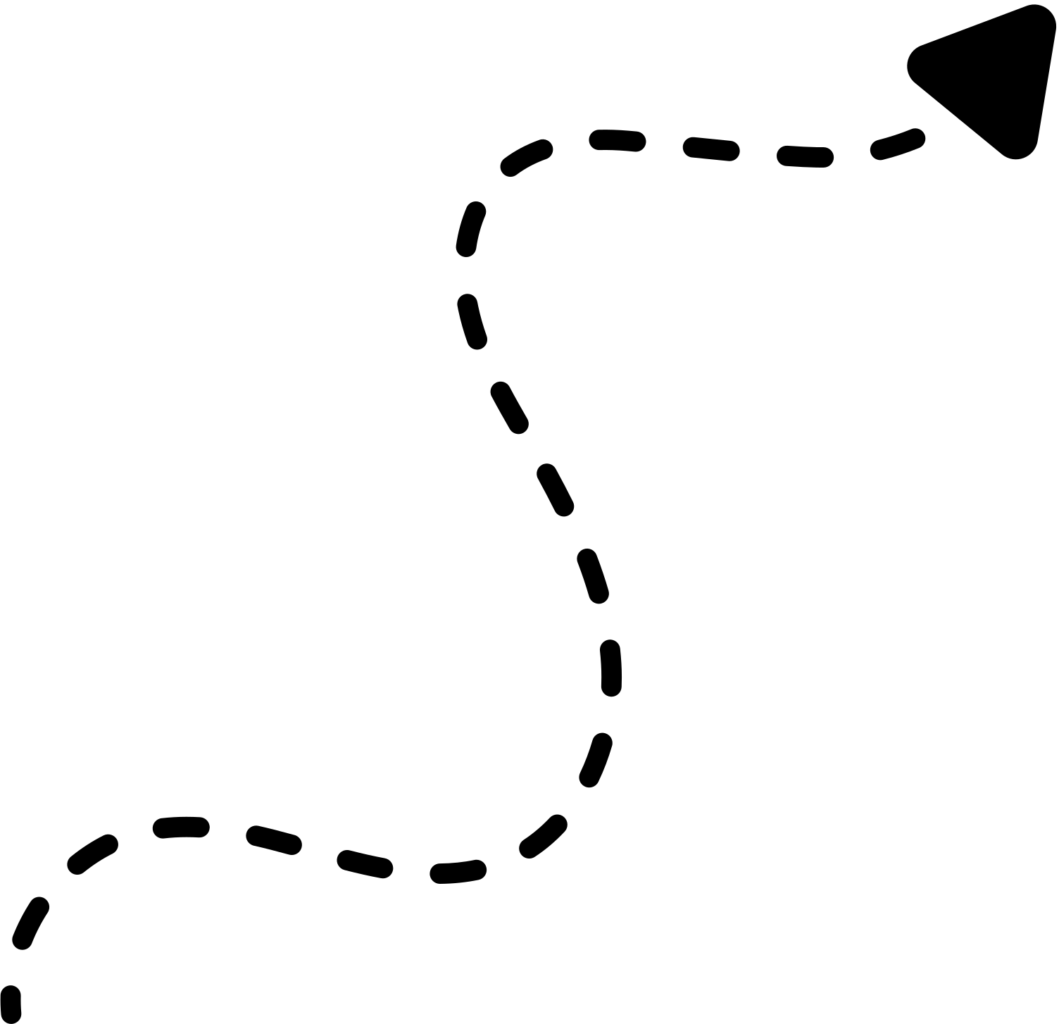
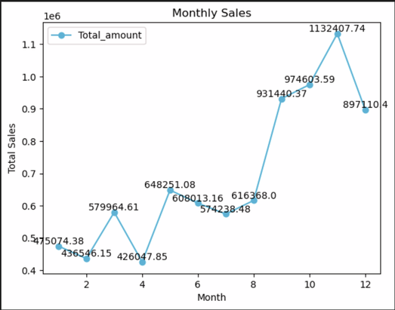
Analysis
Fauget Skincare
Total Sales: The business generated approximately 8.3 million in total revenue from all transactions.
Total Quantity Sold: Around 4.9 million units of products were sold, indicating high transaction volume.
Average Daily Sales: The business achieved an average of 405.67 sales per day, showing consistent sales performance.
Monlthly sales
Sales show slow start with fluctuations in early months
Significant growth and peak in the last quarter (especially November)
Slight decline after peak, indicating seasonal demand pattern

Slide 7
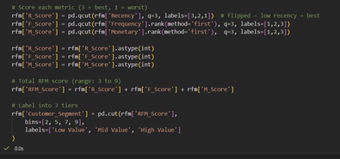
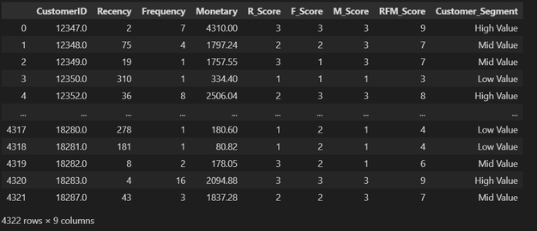
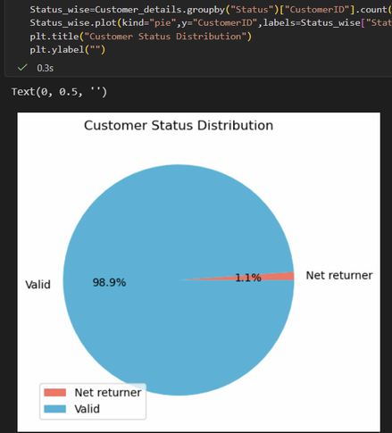
Customer Analysis
Fauget Skincare
Country wise sales
UK is the primary revenue driver (~6.7M sales)
Other countries contribute minimal share (<300K each)
Business is highly dependent on one market (UK)
Majority of customers are valid (98.9%)
Almost all customers contribute positive revenue, indicating a strong and healthy customer base.
Very small portion are net returners (1.1%)
Customers with zero or negative total amount are minimal, showing low return/refund impact on overall business.
Revenue loss from returns is negligible
Since net returners are very few, their effect on total revenue is insignificant

Slide 8
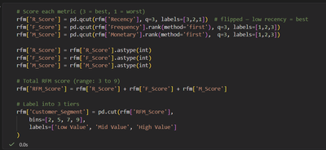
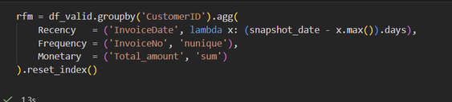
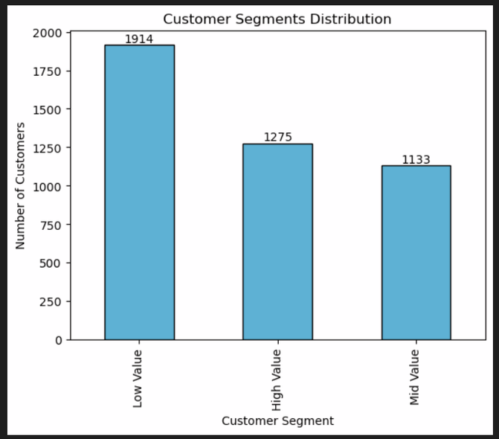
Customer Analysis
Fauget Skincare
Creating the main rfm data set
UK is the primary revenue driver (~6.7M sales)
Other countries contribute minimal share (<300K each)
Business is highly dependent on one market (UK)
Majority of customers are Low Value (1914 customers)
Indicates a large portion of customers have low engagement, low spending, or are inactive.
High Value customers (1275) form a strong core
These customers contribute significantly to revenue and show loyal and consistent behavior.
Mid Value customers (1133) represent growth opportunity
With the right strategy, they can be converted into high-value customers.

Slide 9
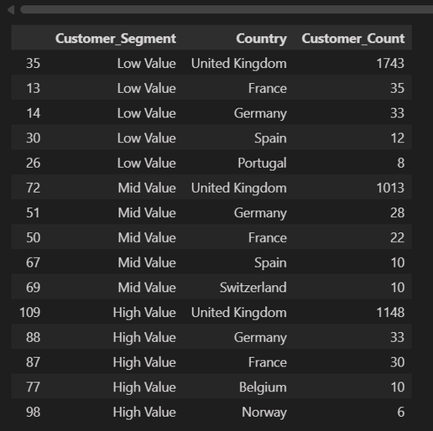
Customer Analysis
Fauget Skincare
United Kingdom ranks highest in ALL customer segments
It leads in Low, Mid, and High Value customers, confirming it is the primary market across all customer types.
Low Value customers are heavily concentrated in the UK
With 1743 customers, the UK has the largest base of low-value users, indicating a major opportunity for conversion and upselling.
High Value customers are also strongest in the UK (1148 customers)
This shows the UK is not only large in size but also drives the most valuable and loyal customers.
Other countries appear consistently but at much lower volumes
Countries like Germany, France, Spain appear across segments, but their contribution is significantly smaller, indicating limited scale outside the UK.

Slide 10
Recommendations
Fauget Skincare
Retain High Value Customers (UK Focus)
Implement loyalty programs, exclusive offers, and premium services to maximize lifetime value and retention.
Convert Low Value Customers into High Value (UK Opportunity)
Use personalized promotions, discounts, and targeted campaigns to increase purchase frequency and spending.
Re-engage Inactive / Low Recency Customers
Launch email campaigns, reminders, and special offers to reduce churn and bring customers back.
Upsell & Cross-sell to Mid Value Customers
Recommend complementary products and bundle offers to increase average order value.
Expand International Presence
Increase marketing efforts in countries like Germany, France, and Spain to grow customer base outside the UK.
Reduce Dependency on UK Market
Diversify geographically to minimize business risk and ensure stable revenue streams.

Slide 11
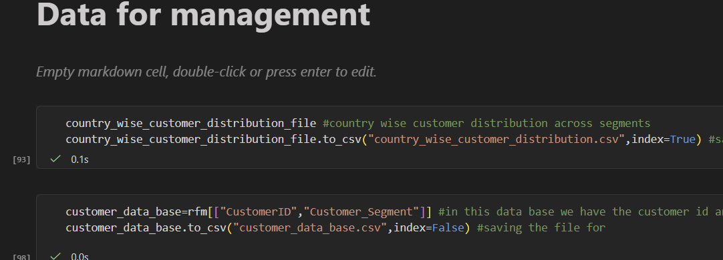
Recommendations
Fauget Skincare
Leverage Data-Driven Marketing
Use RFM segmentation for targeted campaigns to improve ROI and campaign effectiveness.
Optimize Product & Customer Experience
Improve product quality, descriptions, and delivery experience to reduce returns and increase satisfaction.
Additionally, I ensure that the RFM data is extracted as a CSV file, providing management with the necessary dataset for future reference.

Slide 12
Fauget Skincare
Thank
You.
By Niloy Saha Email : nsaha3827@gmail.com

